Slide 1
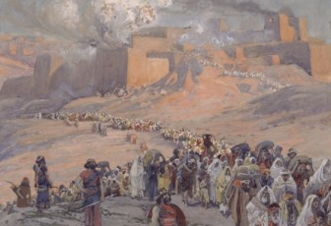
Reasons for the Babylonian Exile
Dr. Rick Griffith • Jordan Evangelical Theological Seminary • BibleStudyDownloads.org
Notes:
Why did God remove the people of Judah from the land that he gave them?

Slide 2
How the
Kingdom Divided
Notes:
Before answering why God kicked them out of the land, let's first see how Israel became two nations.

Slide 3
How the Kingdom Divided
King Solomon started well.
But, he loved many foreign women — Egyptians, Moabites, Ammonites, Edomites, Sidonites, and Hittites.
His 700 princess wives and 300 concubines turned his heart away to their gods when he was old.

Slide 4
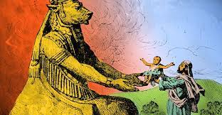
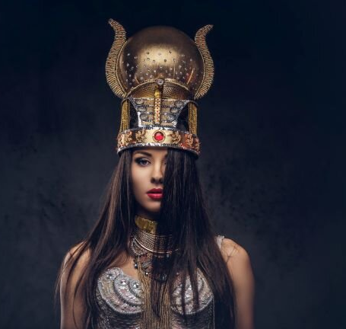
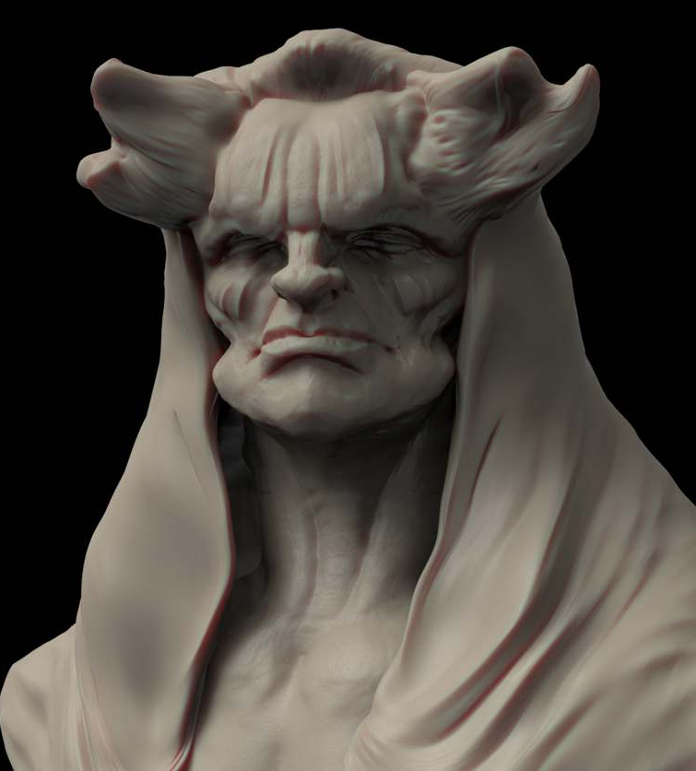
How the Kingdom Divided
1 Kings 11:5
Ashtoreth
goddess of the Sidonians
Molech
god of the Ammonites
Chemosh
god of the Moabites
Notes:
He went after Ashtoreth, the goddess of the Sidonians
He built altars for Chemosh, god of the Moabites (1 Kings 11:5), and
He worshipped Molech, the god of the Ammonites.

Slide 5
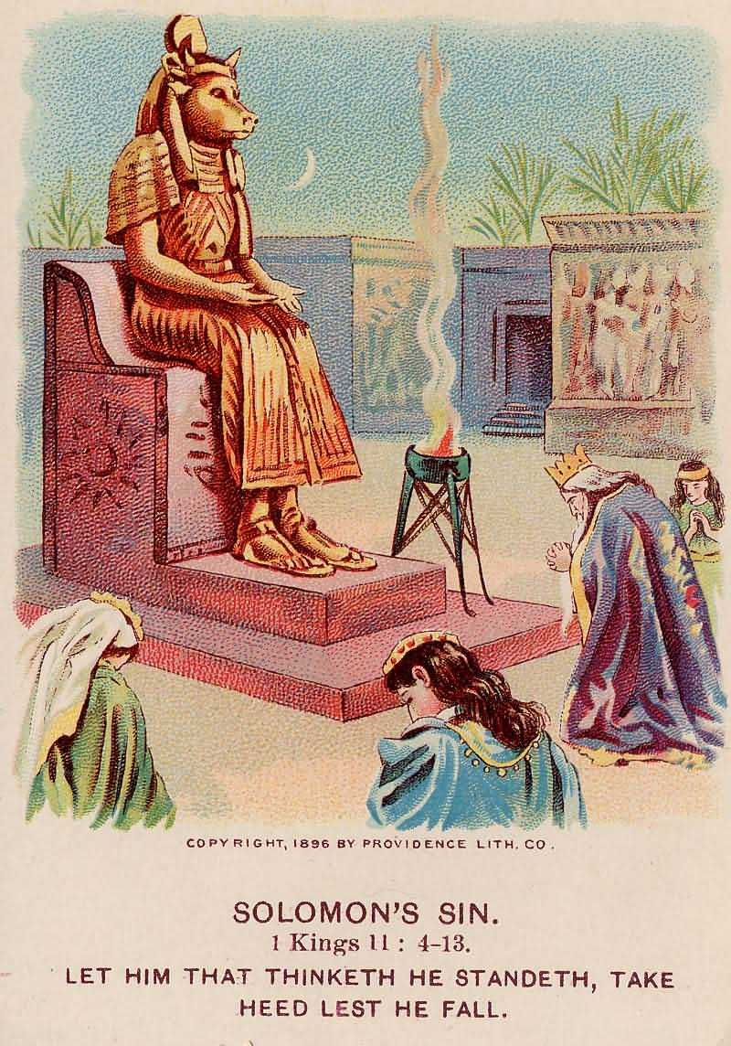
How the Kingdom Divided
Deut 7:3-4
He did not keep what the LORD had commanded:
“Do not intermarry with them… for they will turn your sons away from following Me to serve other gods, and the LORD’s anger will burn against you and will quickly destroy you.”

Slide 6
Results
God tore Solomon’s kingdom from his son, but kept "one tribe" (Judah with Benjamin) for his son for the sake of David (1 Kings 11:13).
This divided the kingdom after Solomon’s death into:
Israel (Northern, 10 tribes)
Judah (Southern, 2 tribes - Judah and Benjamin)
Solomon’s foreign wives introduced Baal worship and other foreign gods that later became widely accepted in Israel and Judah.

Slide 7
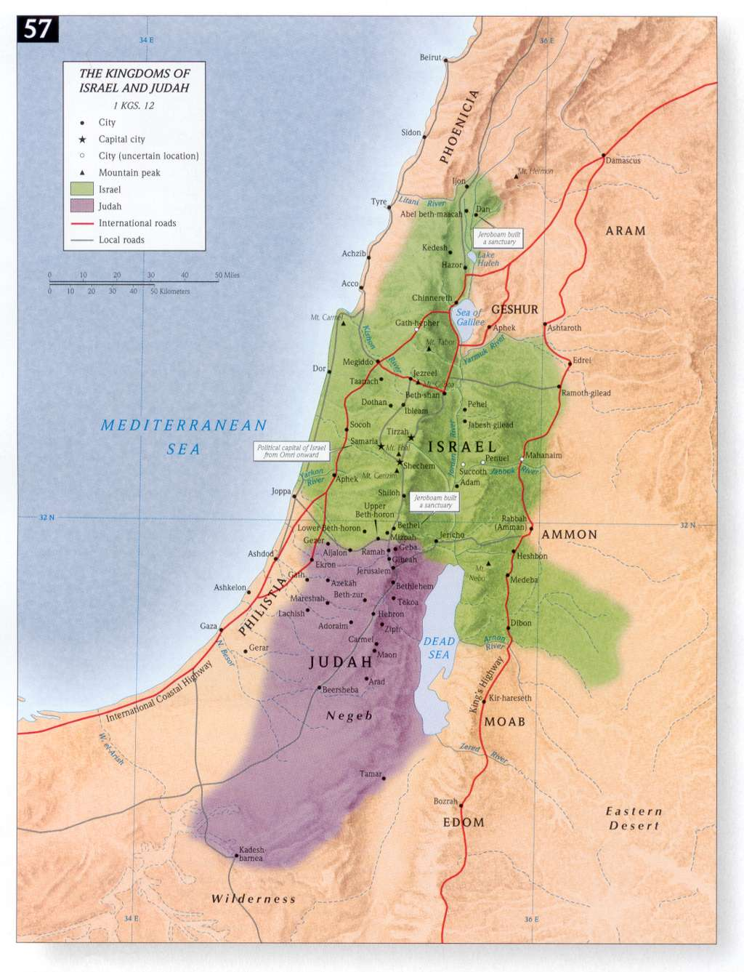
Notes:
Israel and Judah occupied the heartland, though the Philistines and Phoenicians occupied most of the coastland.

Slide 8
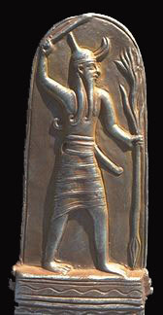
Worship of the Baals

Slide 9
Baal
Supreme male god of the Canaanite nations
Worship of Baal and its other forms (Baalim) prevailed amongst the Moabites and Midianites during Israelites’ wandering in the wilderness
God of rain and fertility
Notes:
Baal means “lord” or “master”

Slide 10
Baal
Baal – holding a mace and a spear tipped with vegetation.
Often portrayed as “rider of the clouds” and described in imagery associated with storms, clouds, and thunder.
Baal and related deities are also portrayed as mating bulls, symbolizing fertility.

Slide 11
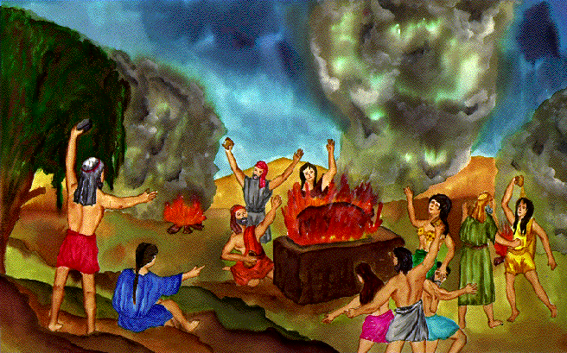
Baal
Worship of Baal involved sacred prostitution—sexual acts by both male and female prostitutes were believed to arouse Baal and gave him vitality to bring rain to make Mother Earth fertile.

Slide 12
Baalim (The Baals)
BAAL-BERITH (the covenant Baal) was worshipped during the judges at Shechem (Judges 8:33; 9:4).
BAAL-ZEBUB (lord of the fly) was worshipped at the Philistine city of Ekron (2 Kings 1:2, 3, 16).
BAAL-PEOR (lord of the opening, i.e., for others to join in the worship), was a Moabite idol (Num 25:1-3).
Hadad god of Canaan, or Adad god of Assyria also related to the Baals.

Slide 13
Why was Baal worship popular?
Canaan was largely arid, so idolatry included trusting Baal as the god of rain to water crops.
The sexual immorality of Baal worship especially appealed to men.
Baal could not speak, so followers could put words into his mouth to pursue their own will.
Notes:
These motivations were financial, sexual, and selfish—the same motivations for idolatry today. Nothing has really changed.

Slide 14
Worship of other gods

Slide 15
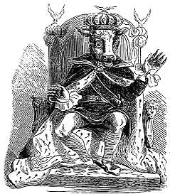
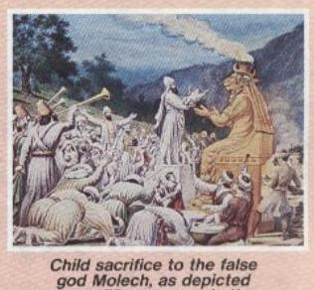
Molech
National deity of the Ammonites (Lev 18:21; Jer 32:35).
Also known as Milcom in the OT (1 Kings 11:5; 2 Kings 23:13; Zeph 1:5), and Moloch in the NT (Acts 7:43).
Fire-god. Worship included the burning of children sacrificed to Molech by their parents.
Ammonites sacrificed their own children to Molech.

Slide 16
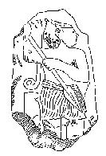
Chemosh
National god of Moabites and Ammonites
Star of ill omens
Worshipped by the sacrifice of children as burnt offerings. Mesha, king of Moab, offered his eldest son to Chemosh (2 Kings 3:27).

Slide 17
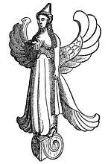
Ashtoreth
Ancient Syrian and Phoenician goddess of the moon, sexuality, sensual love, and fertility.
Modern equivalent
= Venus
The female partner of Baal

Slide 18
Recap
Solomon’s sins in his old age brought judgment from God – division of kingdom into two.
The problem started earlier when Israelites disobeyed God by not driving out the Canaanites and intermarrying with them.

Slide 19
The Divided Kingdoms

Slide 20
Kings of Israel (North)
Jeroboam I (933-911)
- 22 years
Nadab (911-910) - 2 years
Baasha (910-887) – 24 years
Elah (887-886) - 2 years
Zimri (886) – 7 days
Omri (886-875) - 12 years
Ahab (875-854) - 22 years
Ahaziah (855-854) - 2 years
Jehoram (Joram) (854-843)
-12 years
Jehu (843-816) - 28 years
Jehoahaz (820-804) - 17 years
Jehoash (Joash) (806-790) – 16 years
Jeroboam II (790-749) – 42 years
Zechariah (748) - 6 months
Shallum (748) - 1 month
Menahem (748-738) - 10 years
Pekahiah (738-736) – 2 years
Pekah (748-730) - 20 years
Hoshea (730-721) - 9 years
19 kings – ALL BAD!
Notes:
19 kings – ALL BAD!

Slide 21
Kings of Judah (South)
Rehoboam (933-916) – 17 years
Abijam (915-913) - 3 years
Asa (912-872) - 41 years
Jehoshaphat (874-850)
- 25 years
Jehoram (850-843) - 8 years
Ahaziah (843) - 1 year
Athaliah (843-837) - 6 years
Joash (843-803) - 40 years
Amaziah (803-775) - 29 years
Azariah (Uzziah) (787-735)
- 52 years
Jotham (749-734) - 16 years
Ahaz (741-726) - 16 years
Hezekiah (726-697) - 29 years
Manasseh (697-642) - 55 years
Amon (641-640) -2 years
Josiah (639-608) - 31 years
Jehoahaz (608) - 3 months
Jehoiachin (608-597) - 11 years
Jehoiachin (597) - 3 months
Zedekiah (597-586) – 11 years
19 kings and 1 Queen
8 GOOD Kings
Notes:
19 kings and 1 Queen.
8 GOOD kings

Slide 22
Chart of OT Kings & Prophets
232 & 342
Chart of Old Testament Kings & Prophets
John C. Whitcomb, 4th ed. (Winona Lake, IN: BMH Books, 1968), 2
Notes:
For many centuries no one was able to decipher the chronology of the kings of Israel and Judah, as it was so complicated in many ways:
System: Israel had two calendars: a civil calendar that begins with the Feast of Trumpets in Sept (in Tishri, ironically called the 7th month!) and the sacred calendar that began in Nisan at the Exodus in March-April. But which calendar did God’s people use?
Accession: Did the author of Kings count as a full year that portion of the year left when a king was crowned? This accession year would change the dates significantly, considering that we are talking about 39 rules in both Israel and Judah.
Finally, in the late 20th century, Seventh-day OT scholar Edwin Thiele (pronounced TEE-lee) figured out the chronology.
a) Judah and Israel had two dating systems of accession years based on different calendars (civil v. secular). Further, this switched twice in terms of whether the accession or non-accession system was used.
b) Added to the above, several times a king continued to rule after his son had already been crowned, leading to a co-regency—both in Israel and in Judah.
c) Twice in Israel, two kings were vying for rule at the same time, and
d) A scholar misunderstood the above factors along the way and tried to correct the chronology in 2 Kings 17–18, but this only complicated matters. Instead, we should just accept the original text as it stands.
________________
Common-300
OS-11-1Kings-192
OS-12-2Kings-42
OS-13-1Chron-49
OS-14-2Chron-30
OS-14-Reasons for Exile-22

Slide 23
Abominations of the Divided Kingdoms

Slide 24
Israel’s and Judah’s sins reached a peak that was worse than the times of Judges.
Worship of Baal and other pagan gods were mixed with worship of God (idolatry + apostasy).
Temples, altars and places of worship were built for Baal and the other gods everywhere.
Widespread evil and sins of murder (human sacrifice) and sexual immorality accompanied idolatrous worship.

Slide 25
God’s laws written in the Ten Commandments and the Books of Law were completely forgotten (not read; Passover not observed).
God’s temple was in disrepair. Articles from the temple were taken out by some kings and enemies.
The bad kings led the people to sin through their examples of idolatry and ungodliness.
The few good kings tried to abolish pagan god worship and re-establish the worship of God and service in the temple. But they did not succeed in turning the hearts of the people back to God.

Slide 26
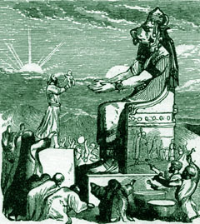
King Ahaz and King Manasseh both sacrificed their children in the fire.
Notes:
During the sacrifices, various drums and instruments were played so loud that mothers could not hear the screams of the babies being burned alive.

Slide 27
Did God keep silent?

Slide 28
God’s Messengers of Wrath & Hope
God sent His Prophets to:
warn about His anger and judgment on them (including exile).
call Israel/Judah to turn from their sins immediately.
speak comfort about a remnant from Judah who would be delivered and return to the land.

Slide 29
Prophets
Israel
Elijah
Elisha
Jonah
Amos
Hosea
Judah
Joel
Isaiah
Micah
Nahum
Zephaniah
Habakkuk
Jeremiah
Obadiah
Ezekiel

Slide 30
Placing the Prophets
342
Placing the Prophets
Key Dates
931
Obadiah
722
Jonah
Amos
Hosea
Isaiah
Micah
Nahum
Zephaniah
Jeremiah
Lamentations
Joel
Daniel
Haggai
Habakkuk
Ezekiel
Zechariah
Malachi
586
Notes:
God raised up prophets to speak to the issues of their day for four centuries from the 800s to the 400s BC.
_______________
Common-308
OS-11-1 Kings-186
OS-12-2 Kings-51
OS-13-1 Chron-232
OS-14-2 Chron-40
OS-14-Reasons for Exile-30
OS-23-Prophets Intro-13
OS-28-Hosea-33
OS-34-Nahum-37
OS-35-Haggai-45

Slide 31
Prophets
But the bad kings
DID NOT
listen to the prophets.

Slide 32
Israel's Assyrian Exile

Slide 33
Israel: Assyrian Exile
Israel was invaded by three or four successive kings of Assyria.
In 740 BC, Tiglath-Pileser carried away the Transjordan tribes (1 Chron 5:26) and the inhabitants of Galilee (2 Kings 15:29, Isa 9:1) to Assyria.
Manasseh
Gad
Reuben

Slide 34
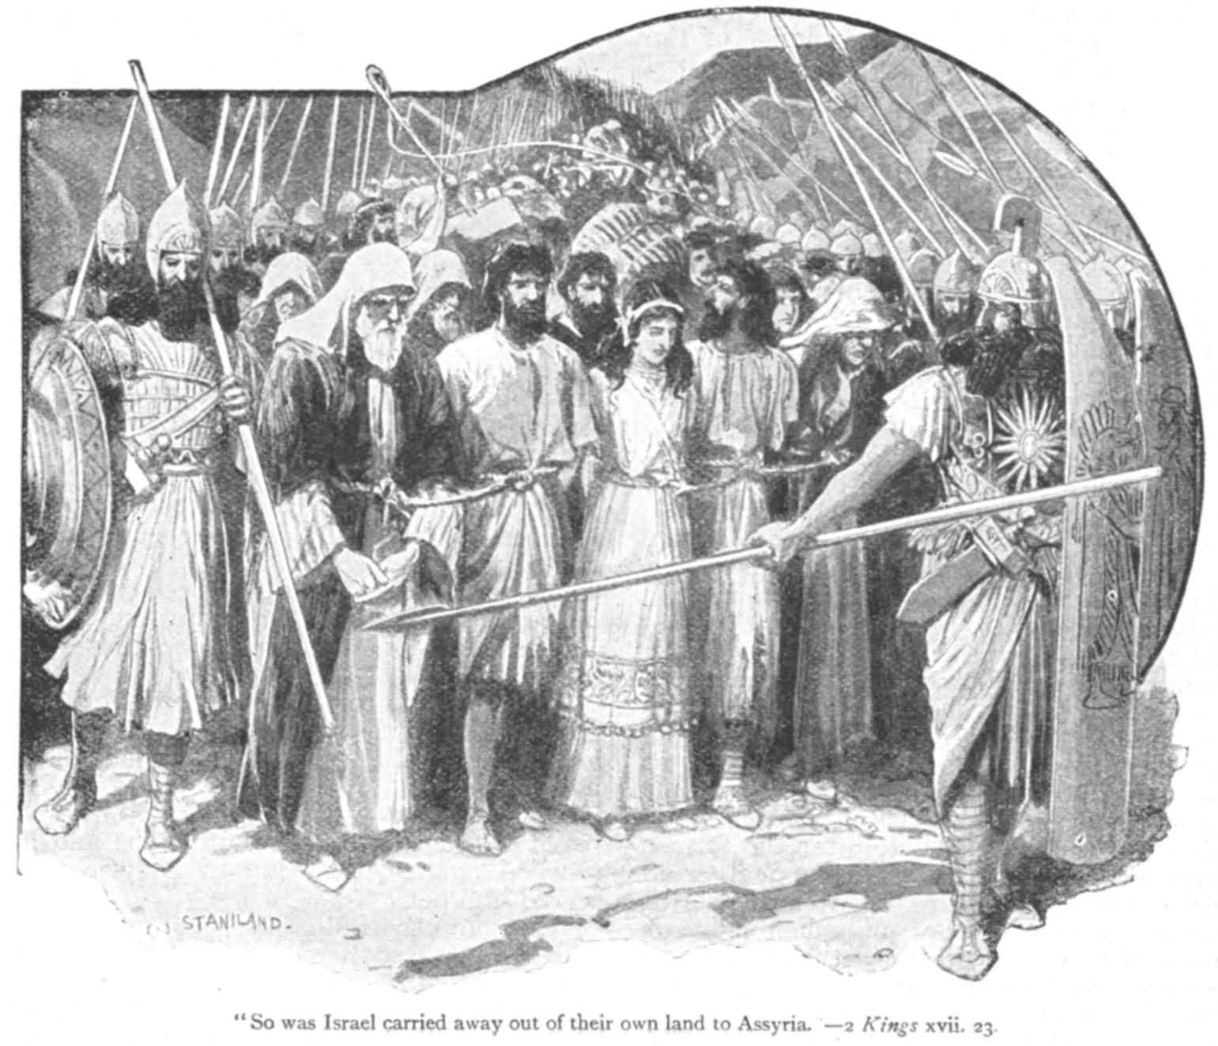
Israel: Assyrian Exile
Shalmaneser invaded Israel twice (2 Kings 17:3, 5) and after a three-year siege took Samaria (722 BC), and then exiled the people to Assyria.
This ended the kingdom of the ten tribes of Israel.

Slide 35
Was Judah any better?

Slide 36
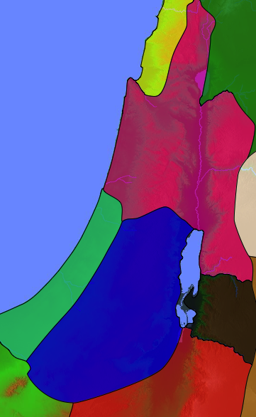
Judah
Judah also worshipped pagan gods.
Some of their kings were particularly evil and defiant to God.
Israel
Judah

Slide 37
King Manasseh 2 Kings 21:3-7
Rebuilt the high places that his father Hezekiah had demolished
Erected altars to the Baals and Asherah poles
Bowed down to all the starry hosts and worshipped them
Sacrificed his sons in the fire in the Valley of Ben Hinnom
Practiced sorcery, divination and witchcraft and consulted mediums and spiritists
Put the carved image he made in the LORD’s temple

Slide 38
King Manasseh
God pronounced judgment on Jerusalem and Judah.
“Manasseh… has committed these detestable sins... Therefore, the God of Israel says: I am going to bring such disaster on Jerusalem and Judah… [that] I will wipe out Jerusalem as one wipes a dish... turning it upside down” (2 Kings 21:11-15).
Notes:
Because of his sins…

Slide 39
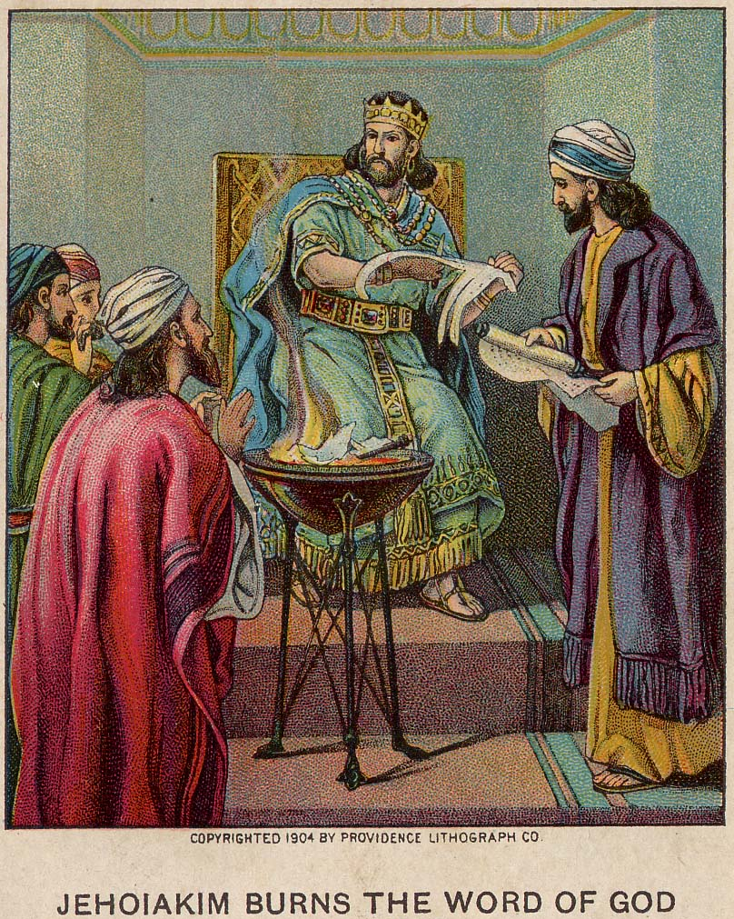
King Jehoiakim
Even after he was defeated by the Babylonians, he did not repent.
God commanded Jeremiah to write down warnings of the destruction of Judah by Babylon as God’s divine judgment.
When the scroll was read to Jehoiakim, he cut and burned it in sections.

Slide 40
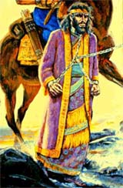
Jeremiah 36:24
“The king and all his attendants who heard all these words showed no fear, nor did they tear their clothes.”
Notes:
“The king and all his attendants who heard all these words showed no fear, nor did they tear their clothes.”

Slide 41
God’s Forewarnings to Kings of Judah

Slide 42
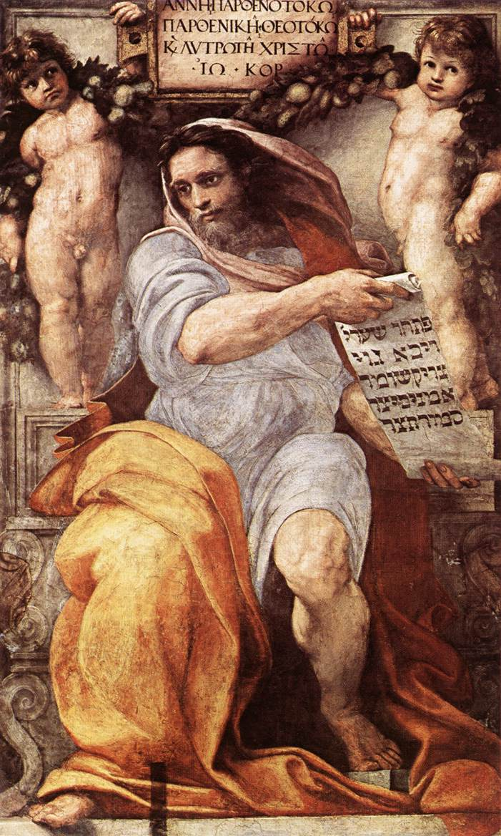
Isaiah to King Hezekiah
Isaiah 39:6-7
“The time will surely come when everything in your palace, and all that your fathers have stored up until this day, will be carried off to Babylon. Nothing will be left… And some of your descendents… will be taken away, and they will become eunuchs in the palace of the king of Babylon.”

Slide 43
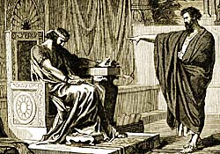
Jeremiah to King Jehoiakim
"Even if Moses and Samuel were to stand before Me, My heart would not go out to this people. Send them away from My presence! Let them go!"
Jeremiah 15:1

Slide 44
Jeremiah to King Jehoiakim
Jer 15:4
“I will make them abhorrent to all the kingdoms of the earth because of what Manasseh son of Hezekiah king of Judah did in Jerusalem.”

Slide 45
Jeremiah to King Jehoiakim
Jeremiah 16:11-13
“...Your fathers forsook me… and did not keep my law. But you have behaved more wickedly than your fathers… instead of obeying Me. So I will throw you out of this land into a land neither you nor your fathers have known, and there you will serve other gods day and night, for I will show you no favour.”

Slide 46
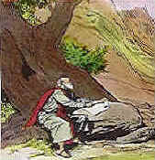
Jeremiah to King Zedekiah
Jeremiah 27:12-13
“I gave the same message to Zedekiah king of Judah. I said, 'Bow your neck under the yoke of the king of Babylon; serve him and his people, and you will live. Why will you and your people die by the sword, famine, and plague with which the Lord has threatened any nation that will not serve the King of Babylon?'”

Slide 47
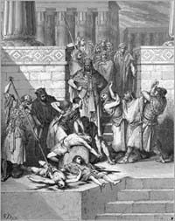
Ezekiel to King Zedekiah
Ezekiel 23:11-35
“…I will bring them against you from every side — the Babylonians and all the Chaldeans, the men of Pekod… because you lusted after the nations and defiled yourself with their idols.”

Slide 48
God’s Call for Judah to Return to Him

Slide 49
God's Call to Return
“Seek the LORD while He may be found; call on Him while He is near. Let the wicked forsake his way….let him turn to the LORD, and He will have mercy on him…for He will freely pardon” (Isa 55::6-7)
“…So turn from your evil ways, each one of you, and reform your ways and your actions…” (Jer 18:11)

Slide 50
God's Call to Return
“Again and again I sent all my servants the prophets to you. They said, ‘Each of you must turn from your wicked ways and reform your actions; do not follow other gods to serve them…” (Jer 35:15)
“Rid yourselves of all the offenses you have committed…. Repent and live!” (Ezek 18:31-32)

Slide 51
God’s words fell on deaf ears. Judah turned their backs ON God, leading to...

Slide 52
Judah’s Babylonian Exile

Slide 53
Nebuchadnezzar's Six Deportations to Babylon
492
Size | Date | King of Judah | Number taken | Key Captives | Results/ Comments
1 Minor | 605 BC | Jehoiakim | Few (Dan 1:3) | Daniel, 3 friends & nobility & royalty | Tribute imposed. Egypt powerful.
2 Moderate | 598 BC | Jehoiakim | 3023 (Jer. 52:28) |  | Minor deportation
3 Major | 597 BC | Jehoiachin | 10,000 (2 Kings 24:14) | Jehoiachin, Ezekiel, Mordecai | Neb. deports many; installs Zedekiah
4 Minor | 587 BC | Zedekiah | 832 (Jer. 52:29) |  | Before destruction
5 Major | 586 BC | Zedekiah | ca. 10,400 (2 Kings 25:11) | Zedekiah | Jerusalem & temple destroyed
6 Minor | 582 BC |  | 745 (Jer. 52:30) |  | 4 years after Jerusalem's destruction
Notes:
Nebuchadnezzar actually had SIX deportations to Babylon. The 597 BC deportation was the third of the six and the first of 2 major deportations, with 10,000 people deported.
_____________________
Common-319
OS-12-2Kings-230
OS-14-2Chron-283
OS-14-Reasons for Exile-51
OS-24-Jeremiah-140
BE-26-Ezekiel-8
OS-26-Ezekiel1-39-slide 78

Slide 54
Babylonian Exile
2 major groups of more than 10,000 left for exile:
(1) Jehoiachin (2 Kings 24:14-16) in 597 BC
(2) Zedekiah (2 Kings 25:11) 587-586 BC
During the exile in 586 BC, the temple of God in Jerusalem was also destroyed.
The length of the Babylonian exile was 70 years (606-536 BC) until the Persian empire replaced the Babylonian empire.

Slide 55
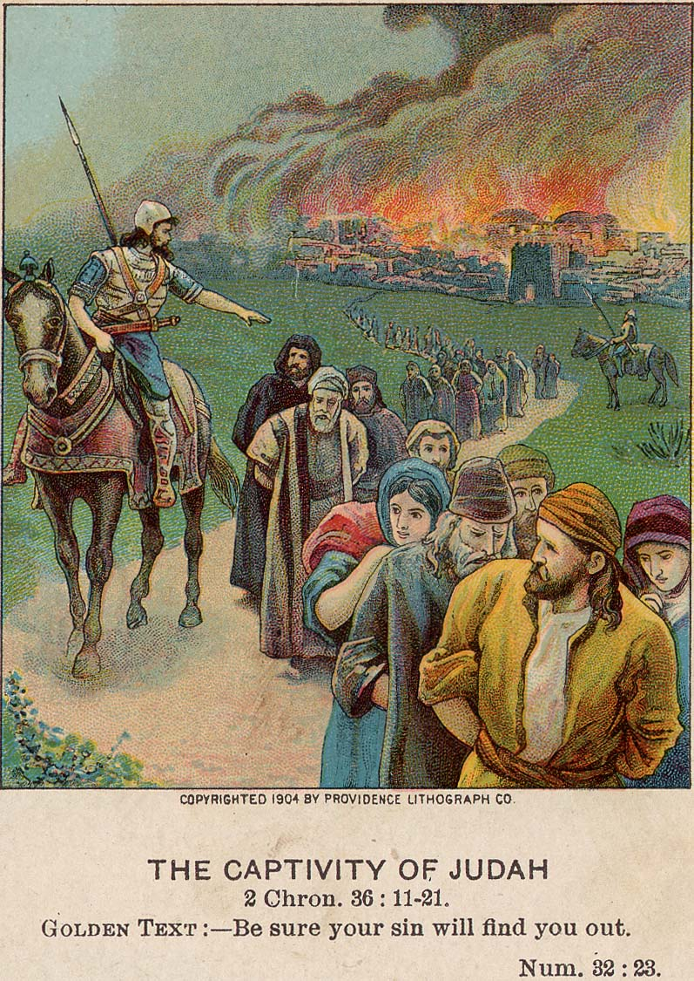
Babylonian Exile
2 Kings 25:8-21; 2 Chron 36:17-21
The Babylonians
killed the young men.
took all the articles from the house of God, the treasures of the king and of his leaders.
burned the temple, the king’s palaces, and all houses in Jerusalem.
broke down the wall of Jerusalem.
carried the people to Babylon to serve the king of Babylon.

Slide 56
Two 70-Year Exiles
560
People Exile
605
586
539
536
516
Temple Exile
"This entire land will become a desolate wasteland. Israel and her neighboring lands will serve the king of Babylon for seventy years. ¹²Then, after the seventy years of captivity are over, I will punish the king of Babylon and his people for their sins," says the Lord. I will make the country of the Babylonians a wasteland forever" (Jeremiah 25:11-12).
Notes:
In 539 BC under the rule of Darius, Daniel read Jeremiah 25:11-12 that limited the exile to 70 years (605-536 BC), or only three years away (9:1-2). But another way to see the 70 years is that the temple lay in ruins from 586 until 516 when the second temple was completed.
Jeremiah does not tell us the exact years that begin and end the 70-year exile.
But we can actually determine this in two ways—either the exile of the people beginning with Daniel’s deportation (605) to the people fully returning in 536, or the exile of the temple from its destruction in 586 to its rebuilding in 516.
_____________________
Common-320
BE-27-Daniel-89
ES-26-Restoration of Israel-186
OS-00-OT Book Overviews-294, 755
OS-12-Kings & Prophets Charts-26
OS-12-2Kings-231
OS-14-2Chron-287
OS-14-Reasons for Exile-54
OS-15-Ezra-14
OS-Esther
OS-24-Jeremiah-53, 141
OS-27-Daniel-94, 284, 340, 361
OS-37-Haggai-9, 32
OS-Zechariah-15

Slide 57
Conclusions

Slide 58
Conclusions
The exiles were God’s judgment on the sins of the kings, leaders, and people.
Their main sins were idolatry, murder, and sexual immorality associated with the pagan practices.
Their failures to fear God, heed His prophets’ warnings, and turn back to God, led them to destruction.

Slide 59
2 Kings 21:11-15
“Manasseh… has committed these detestable sins... Therefore, the God of Israel says: I am going to bring such disaster on Jerusalem and Judah… I will wipe out Jerusalem as one wipes a dish... and turning it upside down.”

Slide 60
2 Kings 24:2-4
“The Lord sent Babylonian, Aramean, Moabite and Ammonite raiders against him (Jehoiakim). He sent them to destroy Judah according to the LORD’s command, in order to remove them from His presence because of the sins of Manasseh... For he had filled Jerusalem with innocent blood, and the LORD was not willing to forgive.”

Slide 61
2 Chronicles 36:14-17
"Furthermore, all the leaders of the priests and the people became more and more unfaithful… and defiling the temple of the LORD... in Jerusalem. The LORD, the God of their fathers, sent word to them through His messengers again and again, because He had pity on His people and on His dwelling place. But they mocked God’s messengers, despised His words and scoffed at His prophets until the wrath of the LORD was aroused against His people and there was no remedy. He brought up against them the king of the Babylonians... God handed all of them over to Nebuchadnezzar.”

Slide 62
2 Kings 24:20
“It was because of the LORD’s anger that all this happened to Jerusalem and Judah, and in the end He thrust them from His presence.”

Slide 63
Was this The end of Judah and the Davidic Covenant?

Slide 64
NO!
YOU ARE RIGHT!
A REMNANT from Judah was saved!

Slide 65
Jerusalem's Fall
232
&
342
Jerusalem's Fall
Key Dates
627
Jeremiah
605
Daniel
597
Ezekiel
586
538
Joel
Lamentations
Habakkuk
Notes:
God raised up at least six prophets in association with the destruction of the first temple in 586 BC (many say 587 BC). Four spoke in Judah itself, which Daniel and Ezekiel ministered to those already brought to Babylon, as they were.
____________
Common-317
OS-12-2Kings-223
OS-14-2Chron-282
OS-14-Reasons for Exile-63
OS-24-Jeremiah-37, 212, 236
OS-27-Daniel-105

Slide 66
God’s Messengers of Hope
Habakkuk’s vision - Jehovah would destroy the Chaldeans and deliver Israel (Hab. 2).
Ezekiel’s vision - God’s throne chariot emerged from the north (Babylon) indicating that Jehovah had not forsaken them.
Ezekiel predicted resurrection of Judah’s statehood, restoration of its remnant, and a glorious future re-established in its own country.

Slide 67
Return to the Land
Shortly before 536 BC, the Babylonian empire fell to the Persian empire.
The Persian kings Cyrus and Artaxerxes allowed the Hebrew exiles to return to the land in 3 groups to rebuild the Temple and wall in Jerusalem.

Slide 68
God’s Firm Decree
Return must take place. Zerubbabel must return to the land so that his descendent, Christ, could be born in the land just as God had said.
The Davidic covenant was not broken because of Judah’s exile. Christ, in the Davidic line, will reign forever.

Slide 69
Applications

Slide 70
Applications
Take God’s words seriously. What He says, He will do.
Disobedience to God leads to chastisement and destruction; repentance and full obedience lead to blessings and life.
God is merciful. He warned them even before they entered Canaan (Deut 28:36, 49, 64), and continued to warn until He had to punish them for their sins.

Slide 71
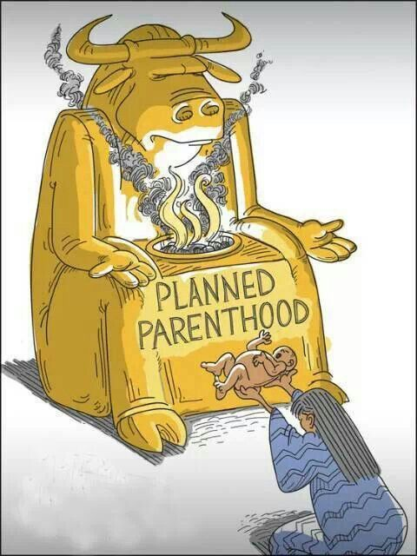
Applications
We must value children and not sacrifice them to the modern gods of Molech.
Notes:
The Altar of Molech
Posted on August 7, 2015 by Fred Dominguez under Bulletin Articles
https://letgodbefoundtrue.net/2015/08/07/the-altar-of-molech/
The pagan nations that surrounded Israel worshiped some of the most despicable gods of the ancient world. One of the most hideous of these was a god called Molech, who was a favorite of the Ammonite people. A central feature of worship to Molech was offering one’s children as a sacrifice to this god. In the scriptures this human sacrifice is often referred to as making one’s children “pass through the fire” (2 Chr. 33:6). It was such a repugnant practice that God specifically named this god, and this heinous practice, among the many things in which Israel was forbidden to engage (Lev. 18:21).
The altar of Molech as typically a large hollow metal structure with the god’s hands outstretched before him. A fire was built within the base of the image and the entire structure was heated red-hot. When the image was sufficiently hot, the worshiper would place his or her live child on the glowing hands of the altar. The child then was consumed by the heat as a sacrifice to this god.
The very idea of such a thing is repulsive to us, but the scriptures tell us that some of the Israelites performed this abominable practice (Jer. 32:35). The most significant Israelite to do so was evil King Manasseh. In 2 Chr. 33:6 the scripture says that he made his sons pass through the fire in the valley of Ben-Hinnom. It was this wickedness of Manasseh that appears to have been the last straw in ending God’s patience with Judah. Within a few years of Manasseh’s death Judah went into captivity in Babylon.
When we reflect on such practices in the name of religion, we are appalled that people could commit such atrocities. We look back at these ancient peoples and shake our heads at how ignorant and barbaric they were. We congratulate ourselves that we live in a far more civilized and enlightened world than they. In all fairness to these ancient peoples, however, it is clearly evident that our world is no less barbaric than theirs. Nothing illustrates this truth better than recent revelations about what is happening in abortion clinics all over our country.
Living babies, complete with souls given by God (Eccl. 12:7), are literally being torn limb from limb by medical practitioners. Not only this, but various body parts of these murdered babies are being sold for medical research. The barbarity of tearing a living being limb from limb is exceeded only by the hypocrisy of those who justify this abominable practice. While inside the mother’s womb, the child is conveniently called a “fetus”, or “fetal tissue”, as though it is not human. However, once the abortion process begins, the abortionist does so in such a way that “human” organs (hearts, lungs, livers, brains, etc.) will be preserved to be sold for research.
The abortion industry is the modern equivalent of the ancient god Molech. The abortion table is his altar, and the unborn children ruthlessly destroyed by hands who took an oath to first do no harm, are the living sacrifices killed on that altar. It is the height of rebellion to God and to His will that people demand the “right” to terminate unborn human life primarily for their own convenience (statistics confirm that this is the case in most abortions performed today). In this sense the ancients were more righteous, because they believed sacrificing their children would bring their god’s blessings upon them. No such motivation exists in the abortion industry.
In Prov. 6:16-19 Solomon said there are seven things which are an abomination to God. Among them is “hands that shed innocent blood.” God condemned the sacrifice of children in the ancient world, and He is no less displeased with the practice of abortion today, no matter how euphemistically we may refer to it. As Christians we must speak up on behalf of the innocent lives that are being sacrificed on the modern altar of Molech.

Slide 72
Applications
God is sovereign and faithful. He is willing and able to keep His promises and fulfill His purposes despite the failures of men to do their part.

Slide 73
Psalm 145:8, 17, 21
“The LORD is gracious and compassionate, slow to anger and rich in love.
The LORD is righteous in all His ways and loving toward all he has made.
My mouth will speak in praise of the LORD. Let every creature praise His holy name for ever and ever.”

Slide 74
Singapore Bible College Presenters
Michele Ang
Jeff Quek
Nancy Soon
Tan Boon Teng

Slide 75
Black
Notes:
_____________
Common-45

Slide 76
OT Survey link at BibleStudyDownloads.org
Get this presentation for free!
Notes:
OT Survey (os)
_____________
Common-30

